Slide 1
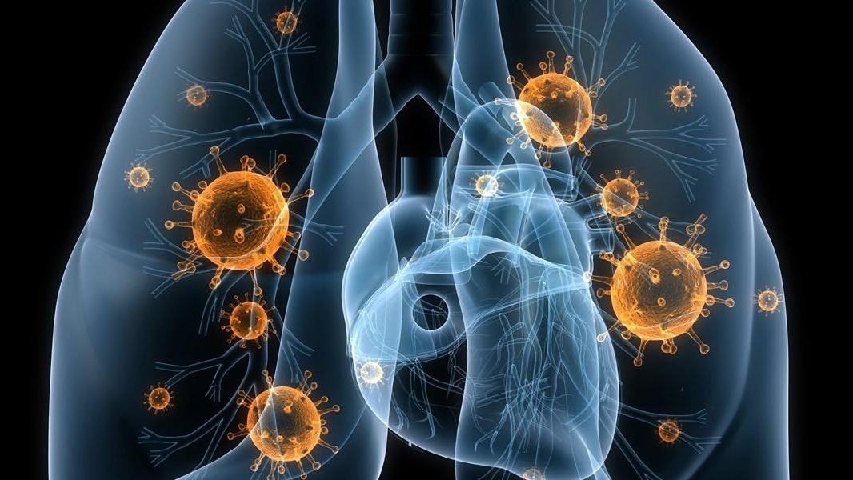
Pneumonia Detection Using Artificial Neural Networks & Transfer Learning Model
Hitarth Pandey(RA1511003010433)
Abhishek Suryavanshi(RA1511003010499)

Slide 2
Abstract
Developing a system that helps in detecting pneumonia in CXR images of lungs, at a high accuracy.Firstly a raw image is being preprocessed with the help of otsu thresholding and an equalizer.
This helps in detecting pneumonia clouds and identifying the ratio of healthy lung region to the total region minimum.The above task is determined by importing the original CXR image in the dataset and then calculating the ratio using cropping of image and applying openCV.
The preprocessed data is then fed into Convolution Neural Network that accurately predicts the percentage of viral and bacterial pneumonia. This helps various radiologist in identifying various prescribed drugs.
Moreover, using transfer learning for better and greater performance.

Slide 3
Introduction
Pneumonia is an infection in one or both lungs. It can be caused by bacteria, viruses, or fungi. Bacterial pneumonia is the most common type in adults.
Pneumonia causes inflammation in the air sacs in your lungs, which are called alveoli. The alveoli fill with fluid or pus, making it difficult to breathe.
According to National Institutes of Health (NIH), chest x ray is the best test for pneumonia diagnosis.
However, reading x ray images can be tricky and requires domain expertise and experience. It would be nice if we can just ask a computer to read the images and tell us the results.

Slide 4
The dataset is organized into 3 folders (train, test, val) and contains subfolders for each image category (Pneumonia/Normal). There are 5,863 X-Ray images (JPEG) and 2 categories (Pneumonia/Normal).
Chest X-ray images (anterior-posterior) were selected from retrospective cohorts of pediatric patients of one to five years old from Guangzhou Women and Children’s Medical Center, Guangzhou. All chest X-ray imaging was performed as part of patients’ routine clinical care.

Slide 5

Literature Survey

Slide 6
Sr.No. | Year of Publication | Author’s Name | Main Focus | Algorithm | Disadvantages | Inference
1. | 2017 | Abhishek Sharma | Detection of Pneumonia Clouds | Otsu Thresholding | Method used is not accurate | Can be used for preprocessing of data
2. | 2017 | Jeremy Irvin,Andrew Ng | CheXnet Radiology Level Detection | CNN 121-Layer Model | Quite Complex & Difficult to Implement | Can be used for detailed analysis of Dataset
3. | 2017 | Li Yao | Learning to Diagnose from Scratch | Multi-label Classification | Interdependencies among the labels | Could be implemented with minimum features
4. | 2016 | Bolei Zhou | Deep Features for localization | Global Average Pooling | Localization could be failed in case of CXR images | Used in various applications like AR

Slide 7
Sr.No. | Year of Publication | Author’s Name | Main Focus | Algorithm | Disadvantages | Inference
5. | 2017 | Yu.Gordienko | Deep Learning with Lung Segmentation and Bone Shadow Exclusion Techniques for Chest X-Ray Analysis of Lung Cancer | UNet-based convolutional neural network | Method used is not accurate | predicting the lung borders in the shape of black-and-white lung masks
6. | 2016 | Zongyuan Ge | Chest X-rays Classification a Multi-Label and Fine-Grained Problem | Multi-Label Learning Loss | Quite Complex & Difficult to Implement | Can be used for detailed analysis of Dataset
7. | 2016-17 | XIUYUAN XU, QUAN GUO, (Member, IEEE) | DeepCXray: Automatically Diagnosing Diseases on Chest X-Rays Using Deep Neural Networks | Transfer Learning Inception V1 | Very highly complex | One of the accurate results

Slide 8
Sr.No. | Year of Publication | Author’s Name | Main Focus | Algorithm | Disadvantages | Inference
8. | 2016 | Pedro Cisneros-Velarde, Malena Correa | Automatic Pneumonia Detection based on Ultrasound Video Analysis | Video Frame Analysis | Cannot determine other results | Can be used for preprocessing of data
9. | 2017 | Liang Liu,Sanjay Mehrotra | Detecting out-of-bed activities to prevent pneumonia for hospitalized patient | Microsoft Kinect V2 | Not enough insights | Hospitalized patients are encouraged by the healthcare giver to move as earlier as possible after the surgery or other medical treatments.
10. | 2016 | Elina Naydenova,Althanasios Tsanas | Smart Algorithms for detection of Childhood Pneumonia | Resource Constrained | Very Limited | SVM Techniques used for feature classification

Slide 9
Inference from the Survey
From the above literature review we believe that our base paper is from the CheXnet Radiology level Pneumonia Detection(Paper 2).
This is because of the predicted accuracy it provides and offers to work on various machine learning models specially CNN Model which is the current system.
The proposed system however uses transfer learning which concludes in a greater performance and the accuracy boost upto 10%.

Slide 10
Main Objective
To demonstrate different conclusions from various other algorithm and selecting the best suited algorithm for the job.
To determine pneumonia with the help of transfer learning.
By determining future insights from data visualization.

Slide 11
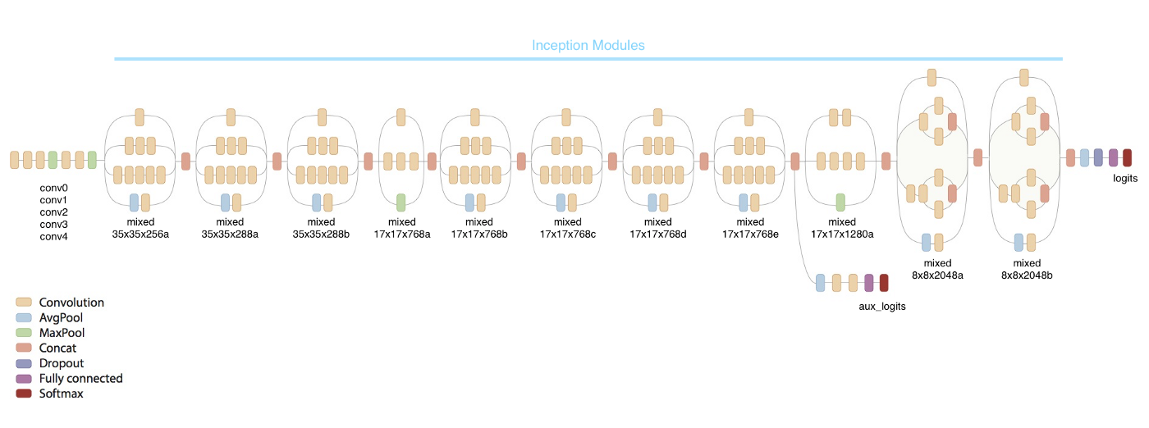
Module Description

Slide 12
Introduction
The task is to binary classify the chest x-ray images into pneumonia and normal. The first model is a simple convolutional neural network. The second model relies on transfer learning from InceptionV3 and is supposed to result in better results.

Slide 13
Inception V3(Image Classification)
Factorizing Convolutions
Auxiliary Classifiers
Efficient Grid Size Reduction
Inception-v3 Architecture
Label Smoothing As Regularization
Ablation Study
Comparison with State-of-the-art Approaches

Slide 14
Transfer Learning
Transfer Learning is the reuse of a pre-trained model on a new problem. It is currently very popular in the field of Deep Learning because it enables you to train Deep Neural Networks with comparatively little data.
This is very useful since most real-world problems typically do not have millions of labeled data points to train such complex models.
This blog post is intended to give you an overview of what Transfer Learning is, how it works, why you should use it and when you can use it. It will introduce you to the different approaches of Transfer Learning and provide you with some resources on already pre-trained models.

Slide 15
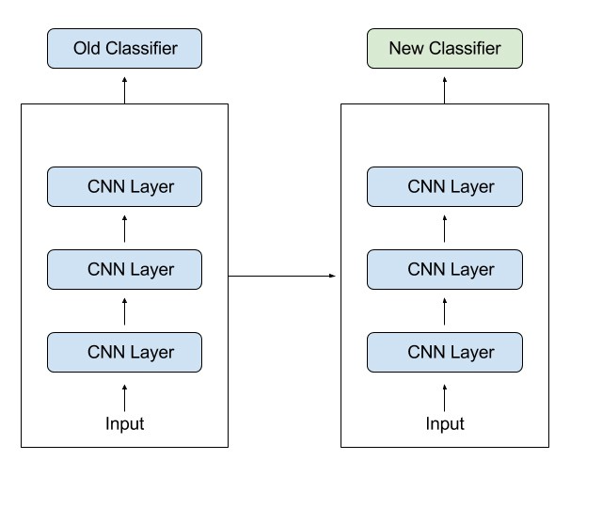
How it works

Slide 16
For example, in computer vision, Neural Networks usually try to detect edges in their earlier layers, shapes in their middle layer and some task-specific features in the later layers. With transfer learning, you use the early and middle layers and only retrain the latter layers. It helps us to leverage the labeled data of the task it was initially trained on.
Let’s go back to the example of a model trained for recognizing a backpack on an Image, which will be used to identify Sunglasses. In the earlier layers, the model has learned to recognize objects and because of that, we will only re-train the latter layers, so that it will learn what separates sunglasses from other objects.

Slide 17
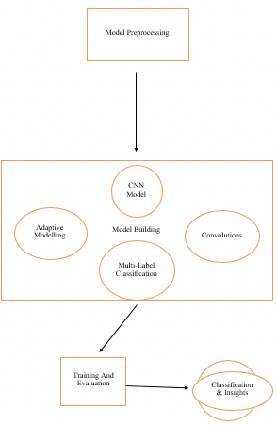
ARCHITECTURE DIAGRAM

Slide 18
Screen Shots

Slide 19
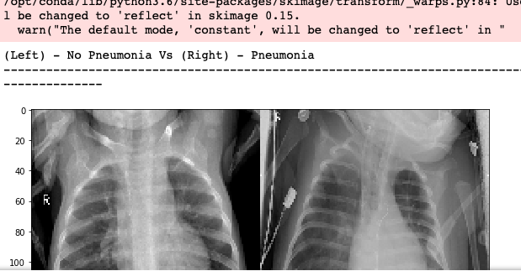

Slide 20
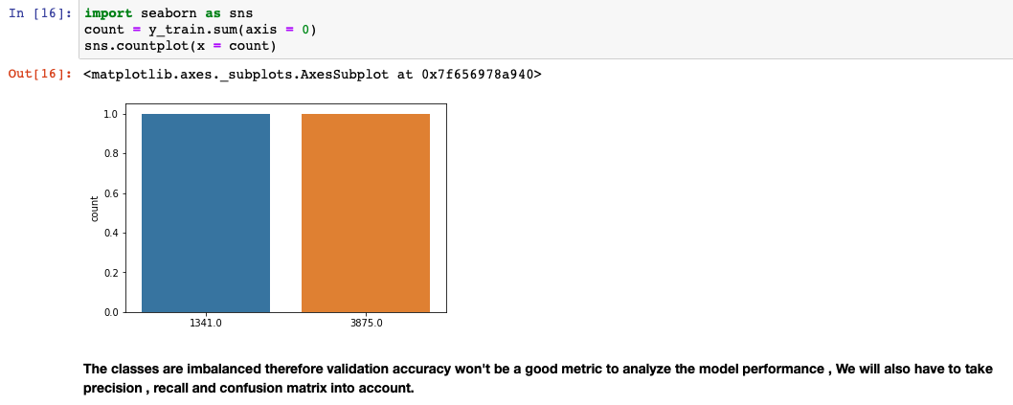

Slide 21
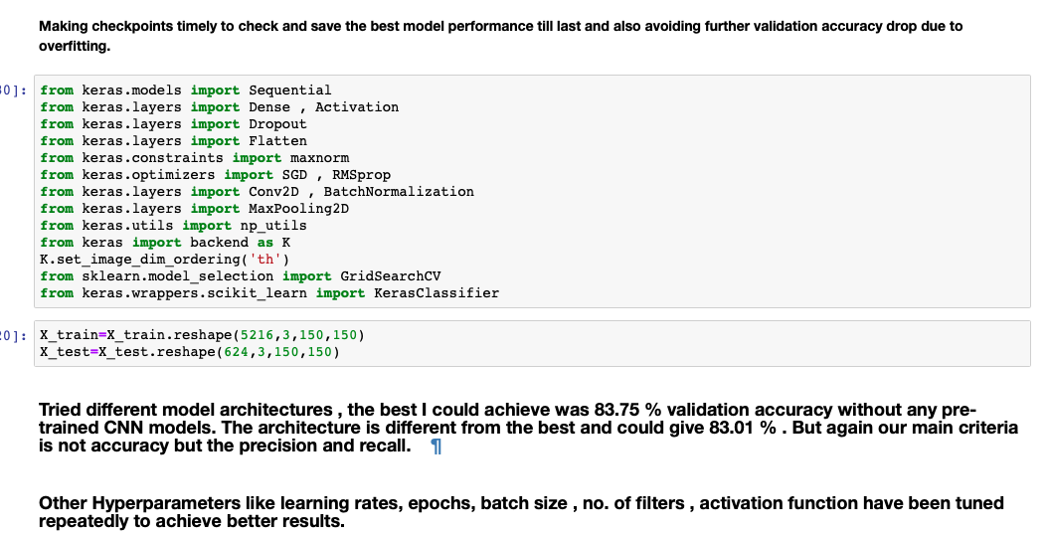

Slide 22
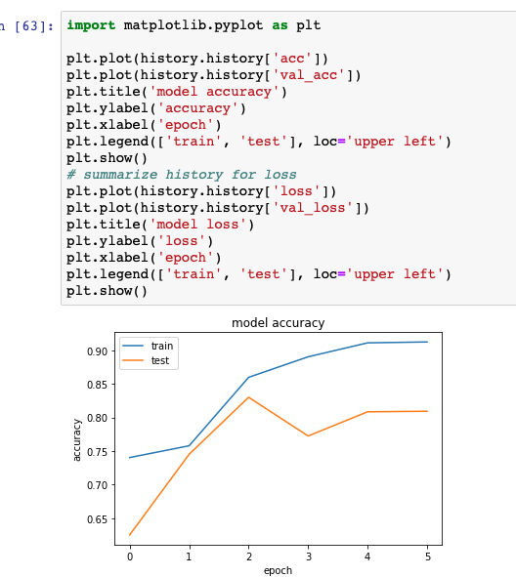

Slide 23
References
1. Abhishek Sharma,Daniel Raju,Sutapa Ranjan "Detection of Pneumonia clouds in Chest X-ray using Image processing approach”-2017
2. Cisneros-Velarde, P., Correa, M., Mayta, H., Anticona, C., Pajuelo, M., Oberhelman, R., ... Castaneda, B. (2016). Automatic pneumonia detection based on ultrasound video analysis. 2016 38th Annual International Conference of the IEEE Engineering in Medicine and Biology Society (EMBC). -2016
3 . Pranav Rajpurkar,Jeremy Irvin,Kaylie Zhu,Brandon Yang,Hershel Mehta,Tony Duan,Daisy Ding,Andrew Y Ng “CheXNet: Radiologist- Level Pneumonia Detection on Chest X-Rays with Deep Learning”- December 2017

Slide 24
4. https://medium.com/technologymadeeasy/the- best-explanation-of- convolutional-neural- networks-on-the-internet-fbb8b1ad5df8
5. https://becominghuman.ai/transfer-learning- retraining-inception-v3-for-custom-image- classification-2820f653c557
6. Pranav Rajpurkar, Jeremy Irvin, et al. CheXNet: Radiologist-Level Pneumonia Detection on Chest X- Rays with Deep Learning, https://arxiv.org/pdf/1711.05225.pdf 2017.
7. Diederik P. Kingma, Jimmy Lei Ba. Adam: A Method for Stochastic Optimization https:// arxiv.org/ pdf/1412.6980.pdf
8. Laurens van der Maaten, Geoffrey Hinton Visualiz- ing Data using t-SNE 2008 http:// www.cs.toronto. edu/⇠hinton/absps/tsne.pdf

Slide 25
9. S. Hwang, H.-E. Kim, J. Jeong, and H.-J. Kim, “A novel approach for tuberculosis screening based on deep convolutional neural networks,” in SPIE Medi- cal Imaging. International Society for Optics and Photonics, 2016, pp. 97 852W–97 852W.
10. https://www.kaggle.com/tentotheminus9/ normal-vs-pneumonia-keras-in-r
11. A. Kumar, Y.-Y. Wang, K.-C. Liu, I.-C. Tsai, C.- C. Huang, and N. Hung, “Distinguishing normal and pulmonary edema chest x-ray using gabor filter and svm,” in Bioelectronics and Bioinformatics (ISBB), 2014 IEEE International Symposium on. IEEE, 2014, pp. 1–4.
12. Campadelli and E. Casiraghi, “Lung field segmen- tation in digital postero-anterior chest radiographs,” in International Conference on Pattern Recognition and Image Analysis. Springer, 2005, pp. 736–745.
13. https://medium.com/datadriveninvestor/ detecting-pneumonia-with-deep-learning-a-soft- introduction-to-convolutional-neural-networks- b3c6b6c23a88

Slide 26
Publication

Slide 27
https://easychair.org/conferences/overview.cgi?a=21172421

Slide 28
Thank You

